Slide 1
High-resolution Spin Vectorial Measurement on Spin-orbit Interaction Induced Electronic Structure of Low-dimensional System
Taichi Okuda
Hiroshima Synchrotron Radiation Center,
Hiroshima University

Slide 2
Outline
Introduction
Spin resolved ARPES
  ESPRESSO machine
2D
  MoS₂: Spin and Valley coupling
1D
  Au nanowire on Ni(110): 1D-Rashba + TRS breaking
Summary

Slide 3


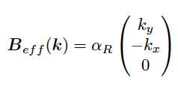


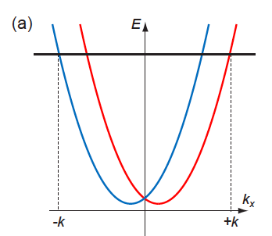
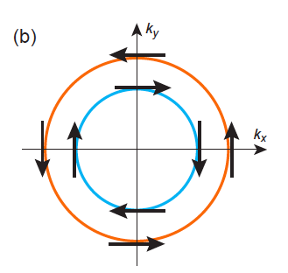

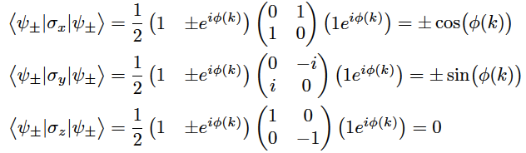
Normal Rashba in ideal 2DEG
Introduction

Slide 4
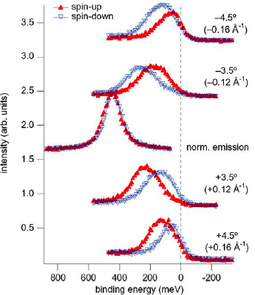
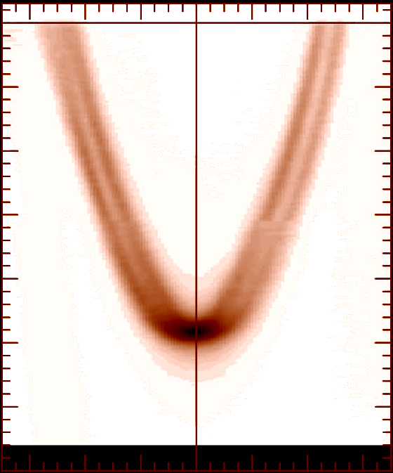
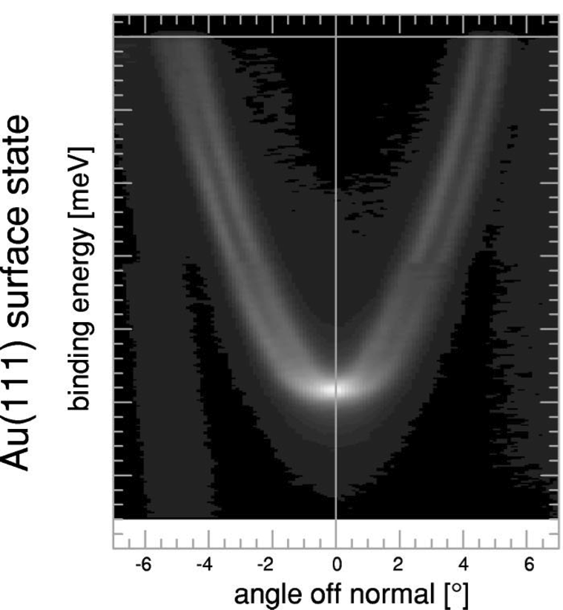
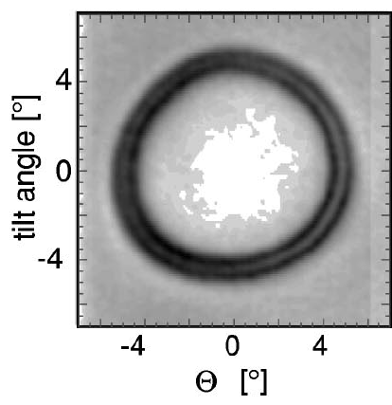
Rashba effect on Au(111)
Introduction
Spin-ARPES
Au(111)
ARPES
M. Hoesch et al. PRB69, 241401(R)(2004).
F. Reinert et al., PRB 63 (2001) 115415.

Slide 5
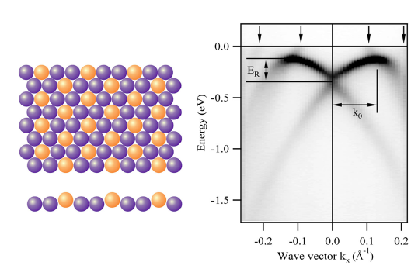
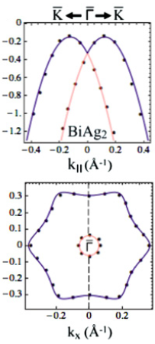
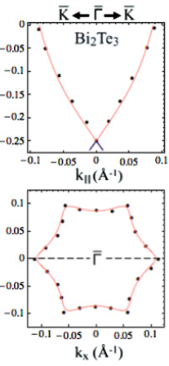
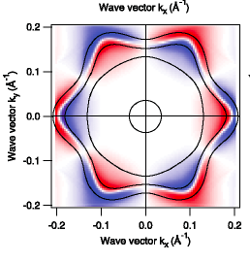
Deviation from the ideal Rashba effect
Introduction
Out of plane spin component by warping effect
Ag₂Bi
C. Ast et al., Phys. Rev. Lett. 98, 186807 (2007).
E. Frantzeskakis and M. Grioni, Phys. Rev. B 84, 155453 (2011).

Slide 6
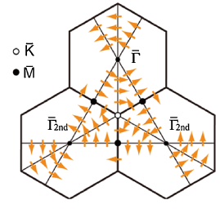
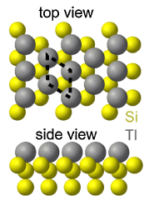
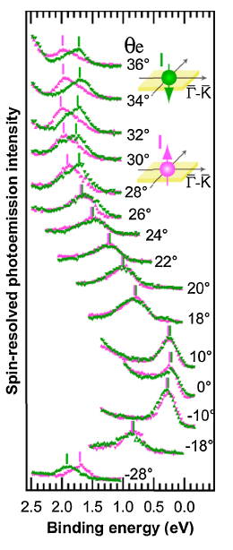
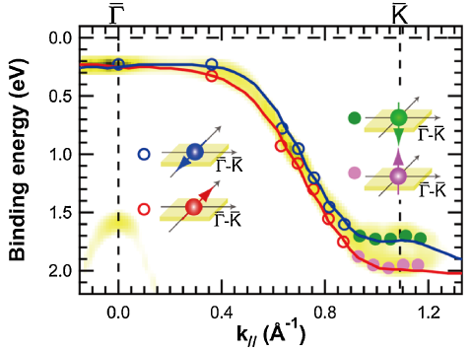
Deviation from the ideal Rashba effect
Introduction
100% out-of-plane spin polarization
by surface structural symmetry (C₃)
Si(111)1x1-Tl
[1] K. Sakamoto, et al., Phys. Rev. Lett. 102, 096805 (2009).

Slide 7
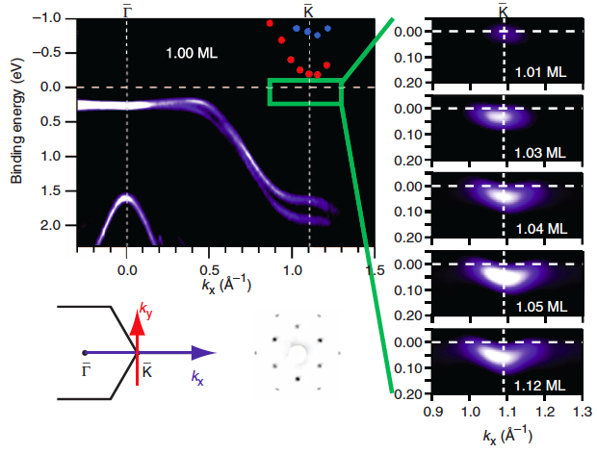
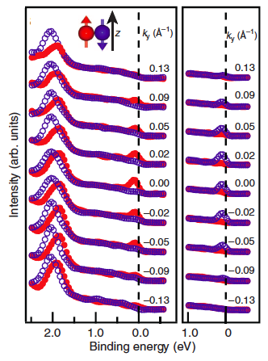
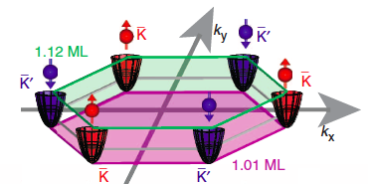
Valley spin polarization by extraordinary Rashba on Si
Introduction
Valley dependent spin polarization is realized in Rashba surface state
K. Sakamoto et al., Nat. Commun. 4, 2073 (2013).

Slide 8
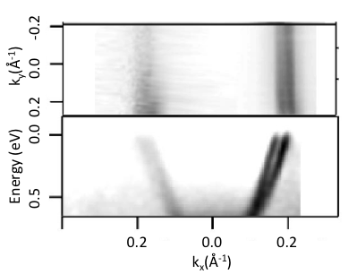
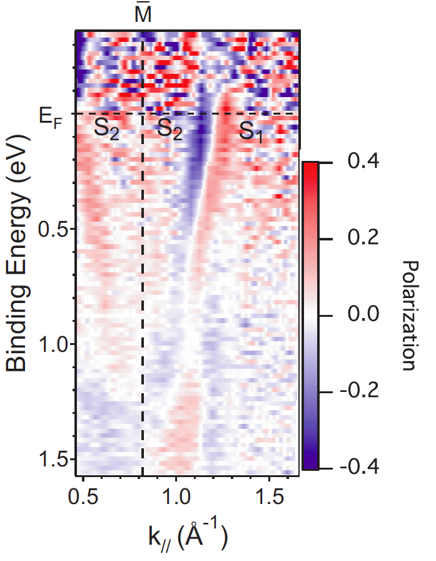
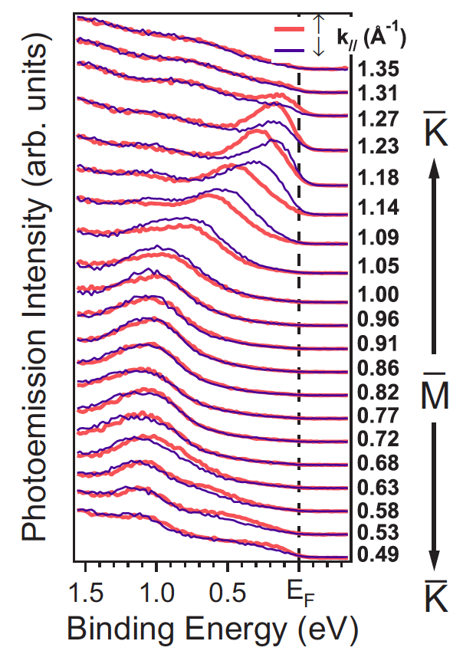
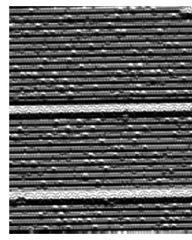
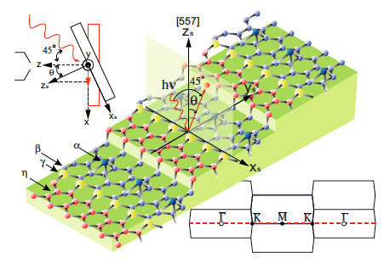
Deviation from the ideal Rashba effect
Introduction
Au/Si(557)
Rashba effect in 1D electronic states
J.N. Crain and F. J. Himpsel, Appl. Phys. A 82, 431 (2006).
T. Okuda et al. PRB82, 161410(R) (2010).

Slide 9
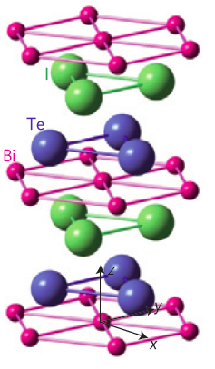
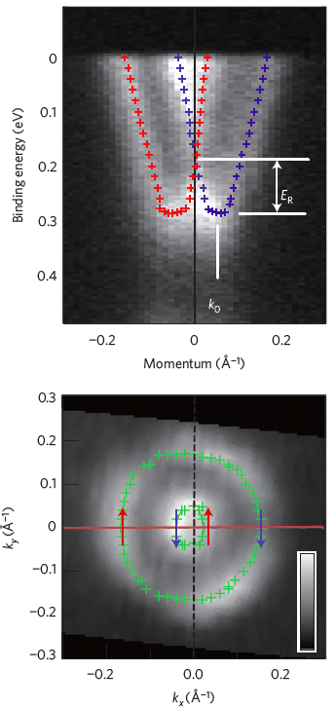
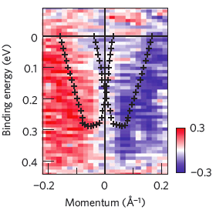
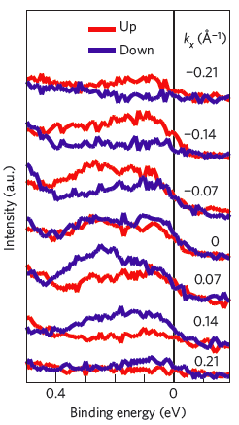
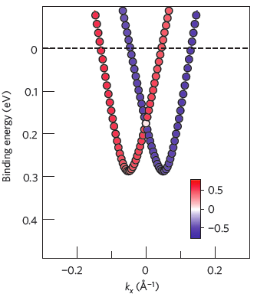
Deviation from the ideal Rashba effect
Introduction
BiTeI
Rashba effect in bulk crystal by breaking of bulk inversion symmetry along Z axis
K. Ishizaka et al., Nat. Mater. 10, 521 (2011).

Slide 10
Today topics
Spin and valley coupling in bulk crystal
  3R-MoS₂
1D Rashba system on magnetic materials
  (1D-Rashba spin split +Time reversal symmetry breaking)
  Au nanowire on Ni(110)

Slide 11
As seen in the introduction,
SOI induced spin polarized states (Rashba system, Topological Insulator etc.) have no net magnetic moment.
Observation of spin property by transport measurement is difficult.
Measurement with spin- and k-resolution is indispensable.
Spin- and Angle-resolved photoemission (SARPES) is one of the most suitable tools to explore and/or investigate new systems.

Slide 12
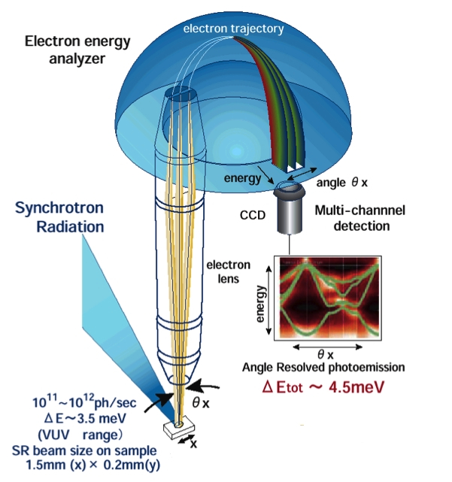
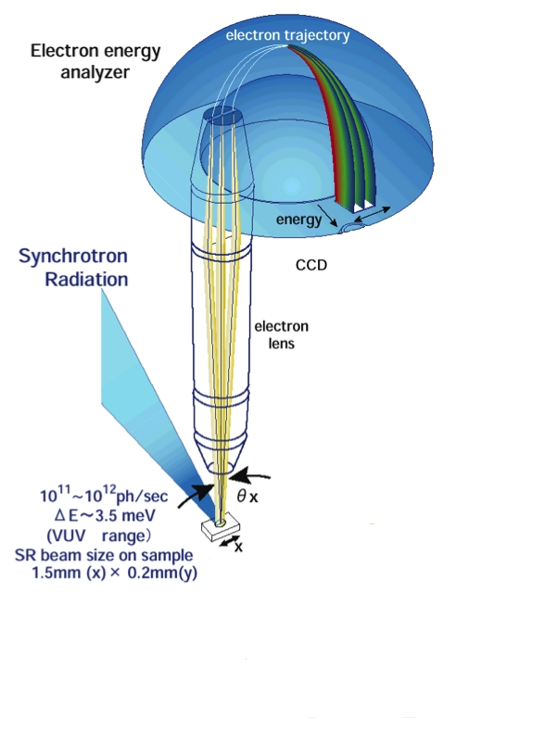
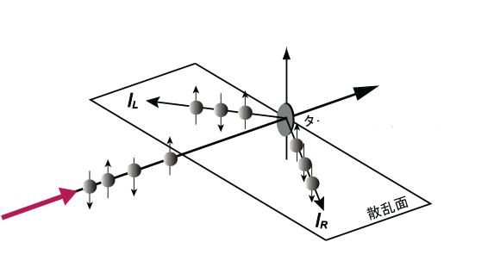
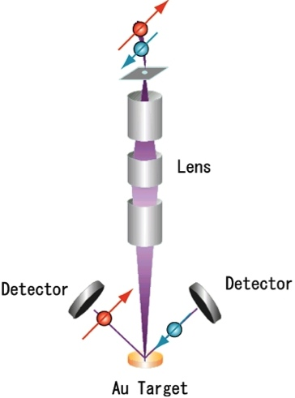
Spin-resolved ARPES
Mott scattering
Spin-Orbit Interaction
Quantization axis
θ=120°
Target (Au, Th etc.)
Scattering plane
Electron
25 kV
Efficiency is 1/10000
Typical energy and angular resolutions
ΔE~ 100-200 meV, Δθ~±1-2°

Slide 13
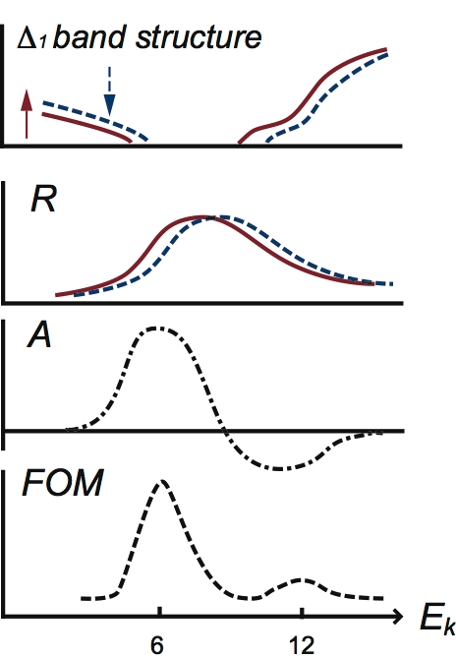
High efficiency spin detector VLEED
Spin dependent electron scattering by Ferromagnetic target (E_{k}~10 eV)
I⁺
I⁻
Fe(001)
film
M
-M
D. Tillemann et al., Z. Phys. B. 77, 1 (1989).
Efficiency of VLEED detector
Electron reflectivity (I/I₀) 1/10 (×10)
Effective Sherman func.(S_{eff}) ~ 40 % (×2-4)
Fe(001) film can be protected by preoxidized surface (Fe(001)p1x1-O)
100 times higher efficiency is realized
Figure of Merit (FOM) 10⁻²
Fe(001)p1x1-O
Fe(001) film
MgO(001) substrate
Lifetime of target is more than a week in UHV

Slide 14

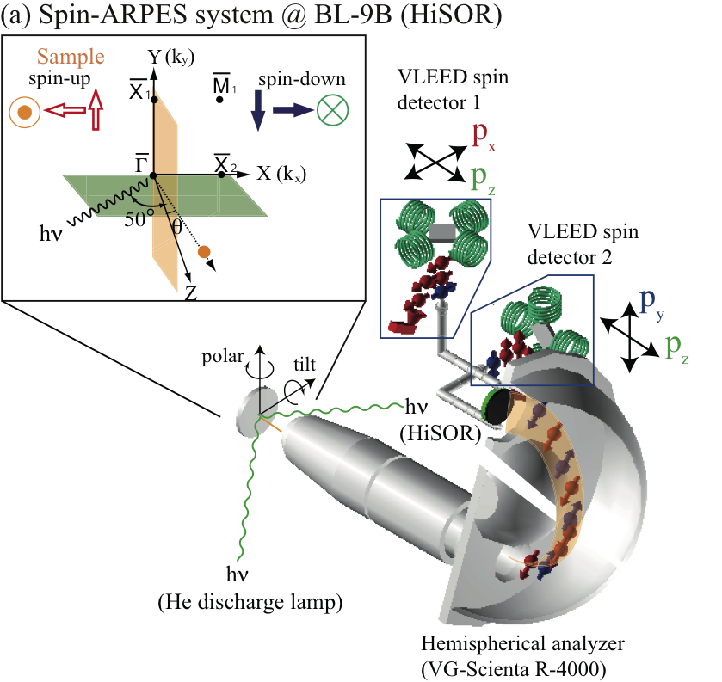
ESPRESSO machine
(Efficient SPin REolved SpectroScOpy)
Apparatuses
Very Low Energy Electron Diffraction (VLEED) spin detector
  FOM = 1.2x10⁻²
  (100 times higher than Mott)
High-resolution hemispherical analyzer (VG-SCIENTA R4000)
Resolution
  Best
  (ΔE, Δθ)=(7.5 meV, ±0.2°)
  Typical
  (ΔE, Δθ)=(~20 meV, ±0.38~0.75°)
Special function
  Efficient normal ARPES
  3D spin vector observation
  (Px，Py，Pz)
T. Okuda et al., Rev. Sci. Insturm.. 82, 103302 (2011).
J. Electron Spectrosc. Relate. Phenom. 201, 23 (2015).

Slide 15

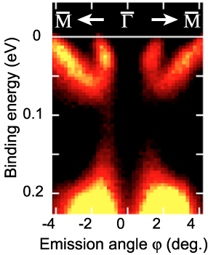
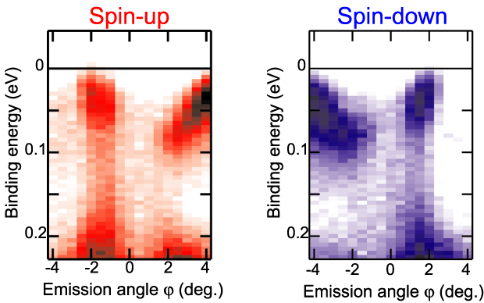
Comparison between Mott and VLEED
SARPES data taken with Mott detector
R. Nishimura., master thesis (2009).
Spin-down
Spin-up
Surface states of Bi(111) by ARPES
Binding Energy (eV)
Binding Energy (eV)
Emission angle(deg.)
Emission angle(deg.)
SARPES data taken with ESPRESSO machine
T. Okuda et al., Rev. Sci. Insturm.. 82, 103302 (2011).
Resolution
×10

Slide 16
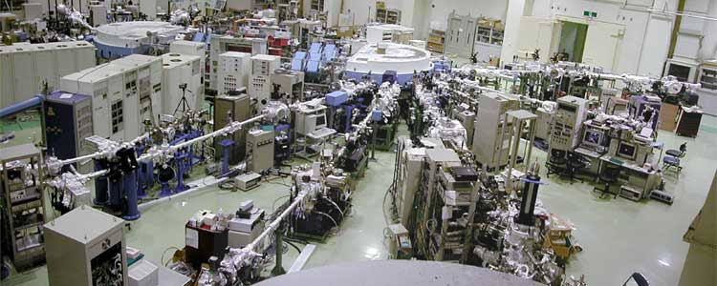
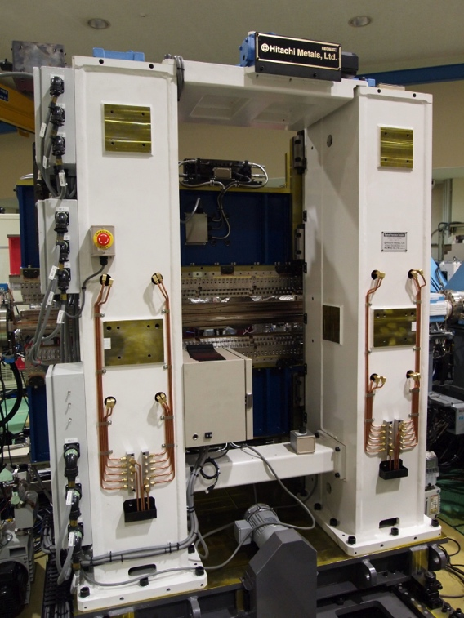
Hiroshima Synchrotron Radiation Center (HiSOR) BL-9B
Storage ring
0.7 GeV Circumference 21.95 m
HiSOR
BL9B (APPLE II)
Photon energy
  16-50-(300) eV
  Xe (8.43 eV)
  He (21.22 eV)
Polarization
  Helical
  Vertical
  Horizontal
Quasi periodic
Apple II undulator

Slide 17
Today topics
Spin and valley coupling in bulk crystal
  3R-MoS₂
1D Rashba system on magnetic materials
  (1D-Rashba spin split +Time reversal symmetry breaking)
  Au nanowire on Ni(110)

Slide 18
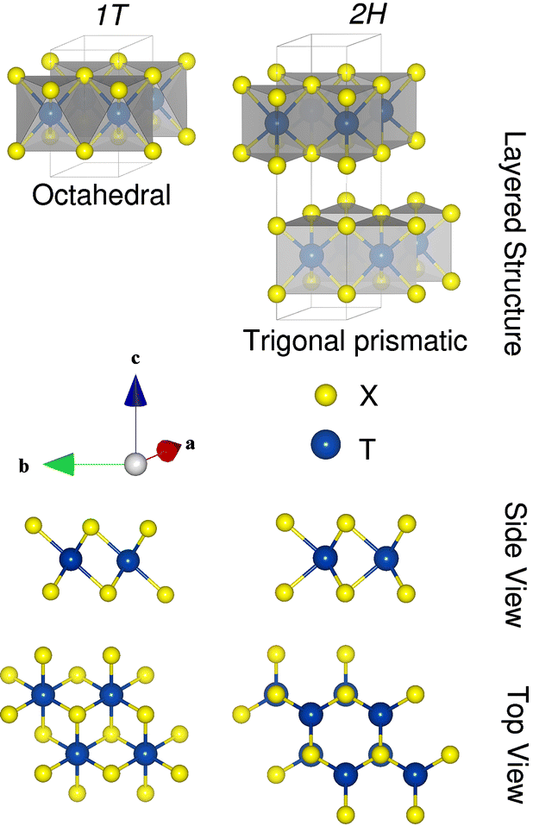
Transition Metal DiChalcogenide (TMDC) MCh₂
MCh₂
M:
Ti, Zr, Hf (Group IV)
Nb, Ta (Group V)
Mo,W (Group VI)
Ch: S, Se
Ionicity
Group IV ➔ Octahedral
Group V
Group VI ➔ Trigonal
Covalency
Agnieszka Kuc, Chemical Modelling: 11, pp 1-29 (2014).

Slide 19
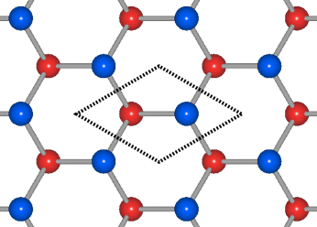
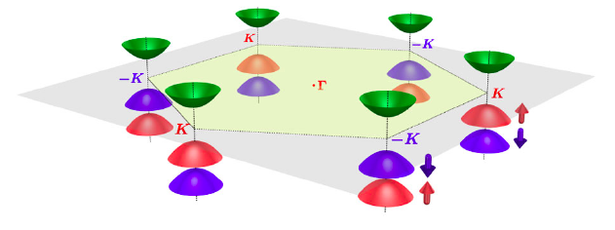
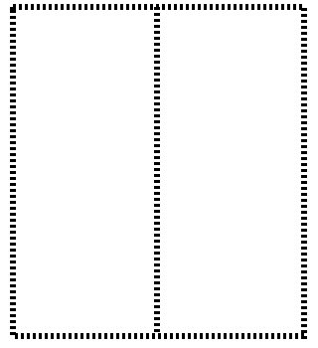
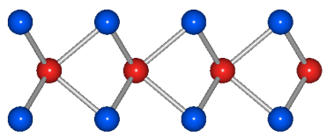

Spin valley coupling in monolayer group IV dichalcogenides (TCh₂ (T=Mo, W, Ch=S, Se))
Trigonal structure
Top view
Side view
Coexistence of
Valley hall effect
Spin hall effect
Strong spin orbit interaction in d electron
Breaking of in-plane inversion symmetry
Effective Hamiltonian in k•p perturbation for VB top around K-point
Pauli matrix for spin
Zeeman type spin splitting at K point
Spin polarization reversal at K and K’
τ = ±1: Valley index
2λ= spin splitting
D. Xiao, G.-B. Liu, W. Feng, X. Xu, and W. Yao, Phys. Rev. Lett. 108, 196802 (2012).

Slide 20
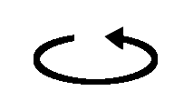
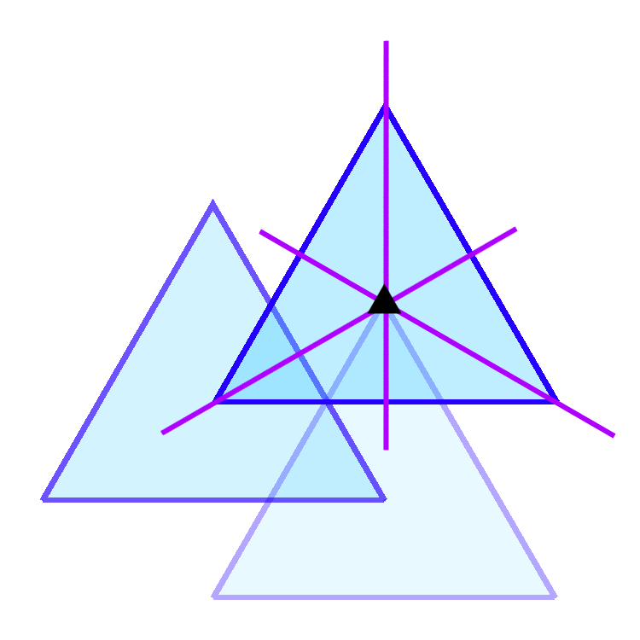
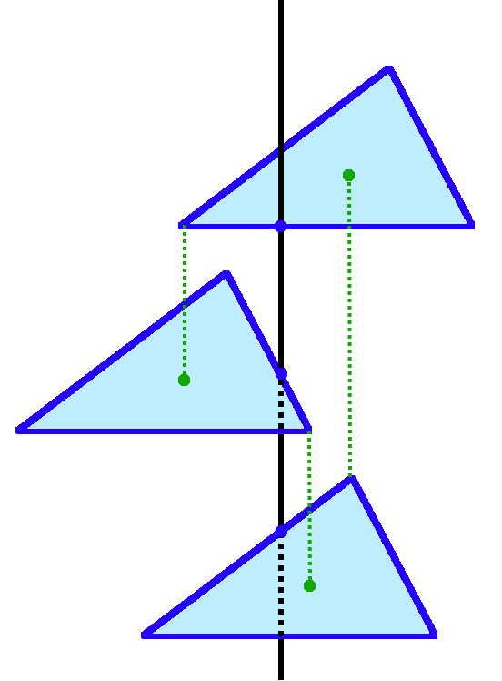
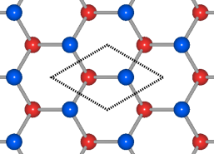

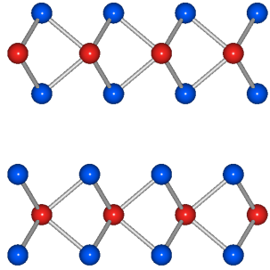

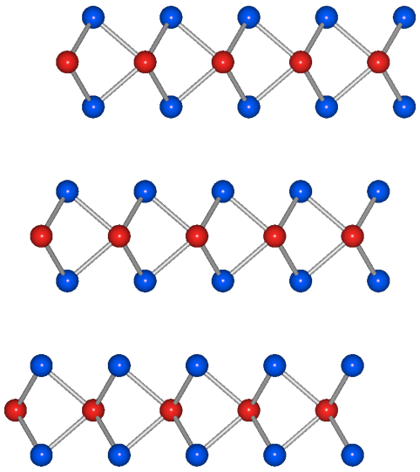



How can we get MoS₂ having in-plane inversion symmetry breaking?
1ML MoS₂
(P6m2)
2H-MoS₂
(P6₃ /mmc)
3R-MoS₂
(R3m)
3-fold axis
Mirror Planes
S
Mo
S
Mo
S
6-fold
z
Point group C_{3v}
3-fold
x
Noncentrosymmetric
Mirror
Planes
Inversion
center
Spin-Valley
coupling in bulk
Noncentro-
symmetric
Centro-
symmetric

Slide 21


Crystal growth and characterization
R. Suzuki et al.
Screw dislocation of 2H and 3R sample
Electron diffraction pattern of 2H and 3R sample
Crystal was grown by chemical vapor transport technique with halogen gas.
I₂ gas ➔ 2H
Cl₂ gas ➔ 3R
Size of crystal
~1x1mm²
6mm
3m

Slide 22




APRES measurement (@ The Univ. Tokyo)
M. Sakano et al.
Photoelectrons
Band dispersions
In vacuum
In solids
Kinetic energy: E_{kin}
Emission angle: θ
Binding energy: E_{B}
Momentum :k
Work function
Sample is cleaved in situ at R. T.
hν = 21.2 (He I α) eV and 40.8 eV (He II)
(He discharge lamp)
T = 15 K
ΔE : 10 meV (He I α), 20 meV (He II)

Slide 23



3R-MoS₂ : Band structure
ARPES image along Γ-K
1st-principles calculation (R. Akashi)
Fermi surface
K
Γ
K
K’
Γ
K
hν = 40.8 eV
hν = 21.2 eV
Fermi surface
hν = 21.2 eV
K
Γ
K’
Projected
2D-Brillouin
zone
Good agreement with calculation
k_{z}
VB; VBM at Γ, valleys at K (K’)
CB; CBM valleys at K (K’) and/or ~0.5Γ-K(K’)
k_{y}
k_{x}

Slide 24





3R- and 2H-MoS2; Top of valence bands at K-point
K
Γ
ARPES images
Calculations
K’
Valence band top at K
k_{z}
k_{y}
k_{x}
0.14
eV
Spin-split
2 bands
3R-
MoS₂
0.17
eV
Spin-
degenerate
4 bands
2H-
MoS₂
3R-MoS₂; Band splitting
at the top of K-point ~0.14 eV
z
x

Slide 25


Spin-APRES measurement @HiSOR BL-9B ESPRESSO machine
Sample is cleaved in situ at R. T.
hν = 20 eV (p-polarized light)
T = 20 K
ΔE : 20-25 meV
Δθ : ±0.75 deg
Spin component projected on the crystal axes
Spin component observed by spin detector

Slide 26




3R-MoS₂; Spin-splitting at K-point
Contour of valence band top
SARPES spectra/spin-polarizations
2H-MX₂
(P6₃ /mmc)
Centrosymmetric
(S_{x}, S_{z})
E-E_{F}
= -2.3 eV
Spin-splittings at BZ corners
Spin-polarization; |P_{z}|~1

Slide 27



3R-MoS₂; Spin-splitting at K-point
ARPES / SARPES image
“Zeeman-type” spin-splitting at K-point
1ML-MX2 k・p effective Hamiltonian for VB top around K-point
Pauli matrix for spin
τ = ±1: Valley index
D. Xiao et al., PRL 108, 196802 (2012).

Slide 28

3R-MoS₂; Spin-splitting at K- and K’-point
Contour of valence band top
SARPES spectra @K, K’
M
E-E_{F}
= -2.3 eV
S_{z} flipping
S_{z} flipping; K ↔ K’
cf. 1ML-MX2 k・p effective Hamiltonian for VB top around K-point
Coupled degrees of freedom
Spin + Valley in bulk
Pauli matrix for spin
τ = ±1: Valley index
D. Xiao et al., PRL 108, 196802 (2012).

Slide 29

Comparison to 2H system
Calculated spin polarization S_{z}
2H-MX₂
(P6₃ /mmc)
3R-MoS₂
2H-MoS₂
Centrosymmetric
(S_{x}, S_{z})
Surface contribution; ruled out

Slide 30





Summary
Results are published in Nat. Nanotech. 9, 611 (2014).
In 3R-MoS₂…
3R-MoS₂
(R3m)
2H-MX₂
(P6₃ /mmc)
Spin-splitting in bulk
Surface contribution; ruled out
Spin-valley coupling; P_{z}~±1 @K, K’
1ML MoS₂
(P6m2)
3R-MoS₂
(R3m)
E
K’
Γ
K
3R-polytype TMDC will enrich
device fabrications and valley/spin related physics.

Slide 31








Coworkers
＜Spin group@ HiSOR, Hiroshima Univ.＞
＜MoS₂ project @ Univ. Tokyo＞
Sample fabrication and characterization
R. Suzuki
Y. J. Zhang
D. Morikawa
Y. Iwasa
ARPES & Spin-ARPES
M. Sakano
K. Ishizaka
K. Yaji
Harasawa
Calculation
R. Akashi
R. Arita
Au/Ni(110) Sample fabrication, characterization STM and Spin-ARPES
T. Warashina
M. Nurmamat
MoS₂ Spin-ARPES
K. Miyamoto
K. Kuroda
A. Kimura
H. Namatame
M. Taniguchi
＜Financial support＞
MERIT, ALPS, GCOE
JSPS, Kiban B 19340078
JSPS, Kiban A 23244066
Thank you for your kind attention!

