Slide 1
Non-Hermitian supersymmetric structures
Ramy El-Ganainy^{1,2}
¹Michigan Technological University (MTU)
²Max Planck Institute for the Physics of Complex Systems

Slide 2
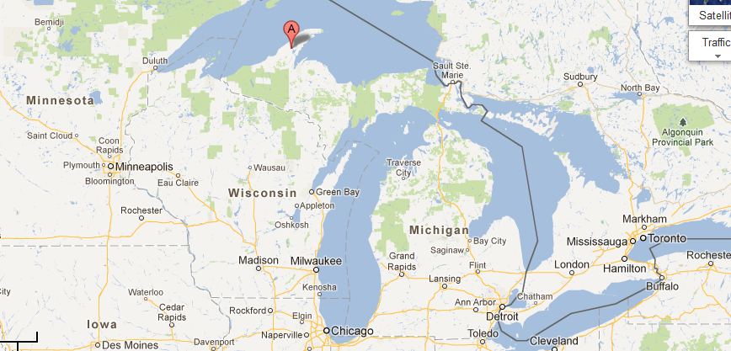
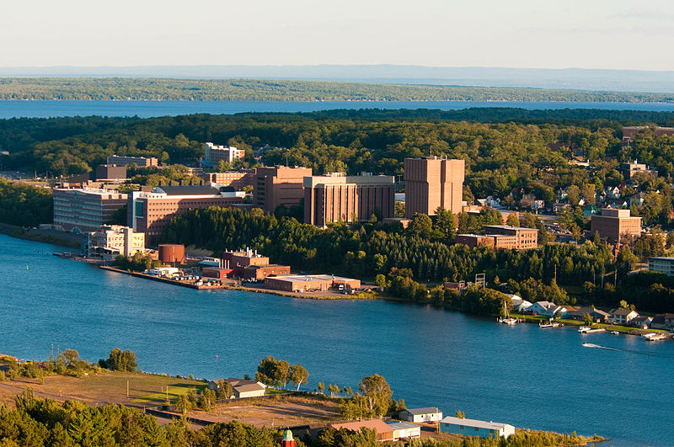

Slide 3
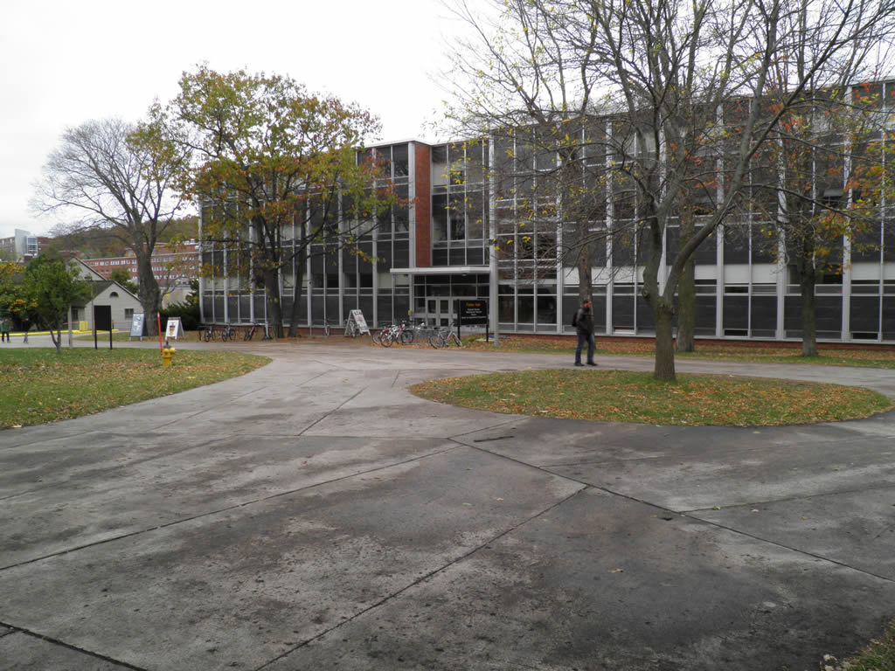
MTU: Physics department
Faculty members: 20
Graduate Students: 40
Research profile:
Astrophysics
Atmospheric physics
Material physics
Photonics

Slide 4
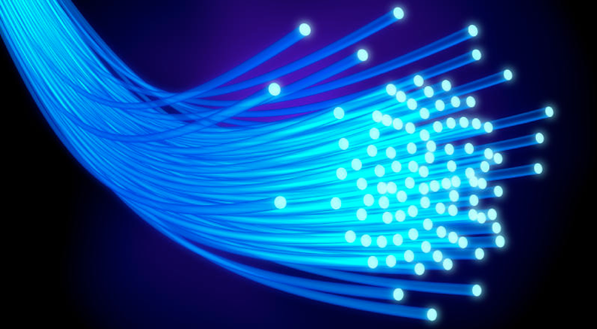
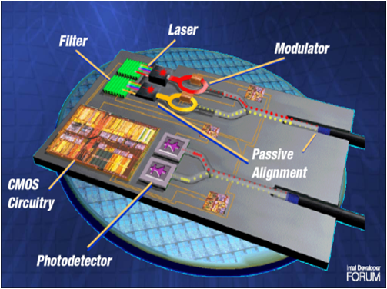
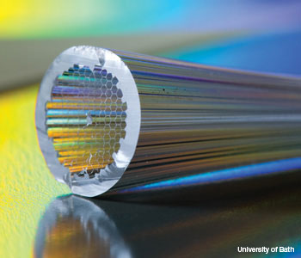
Background
Photonic circuits
Fiber optics
Photonic crystal fiber
Notes:
And now we move on to talk about PT symmetry in optical structures.
We first note that over the last two decades, the field has witnessed a very rapid advance in the material technology that enabled a great control over molding light behavior.
Probably the most prominent examples are photonic band gap materials, metamaterials, plasmonics as well as photonic crystal fibers.
In all these technologies, optical loss has been always considered an obstacle and many efforts have been dedicated to get rid of it.
And this became the conventional wisdom in the field.

Slide 5
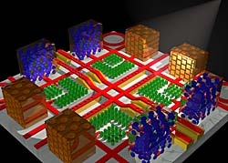
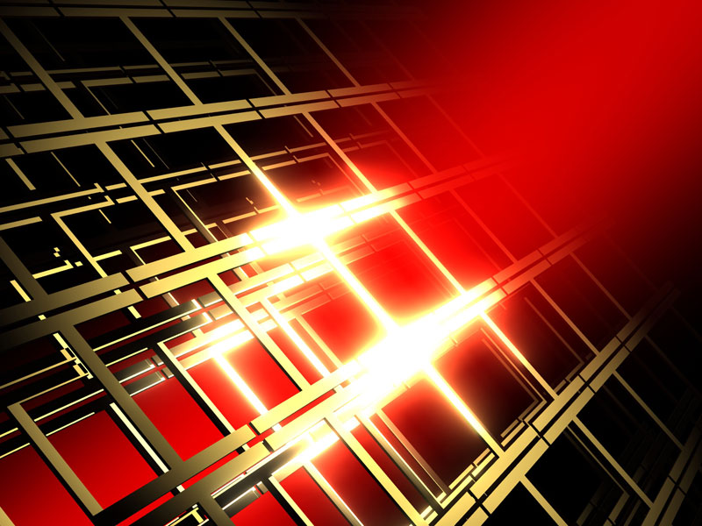
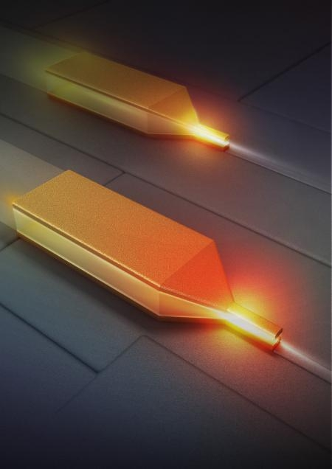
Active research fields
Photonic crystals
Negative index materials
Plasmonics
Notes:
And now we move on to talk about PT symmetry in optical structures.
We first note that over the last two decades, the field has witnessed a very rapid advance in the material technology that enabled a great control over molding light behavior.
Probably the most prominent examples are photonic band gap materials, metamaterials, plasmonics as well as photonic crystal fibers.
In all these technologies, optical loss has been always considered an obstacle and many efforts have been dedicated to get rid of it.
And this became the conventional wisdom in the field.

Slide 6
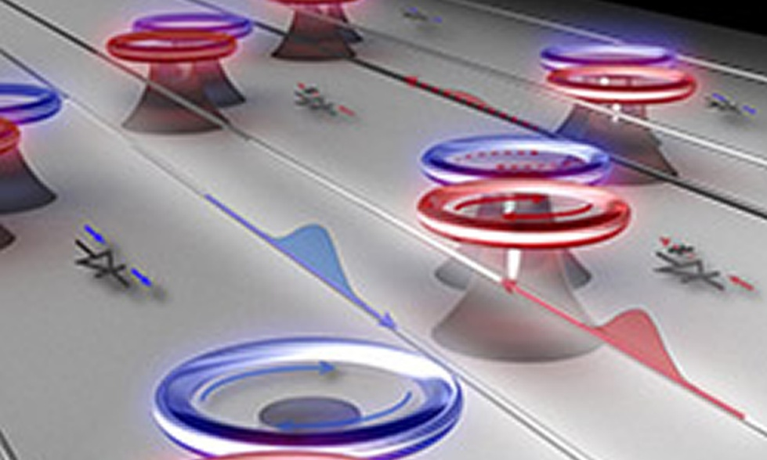
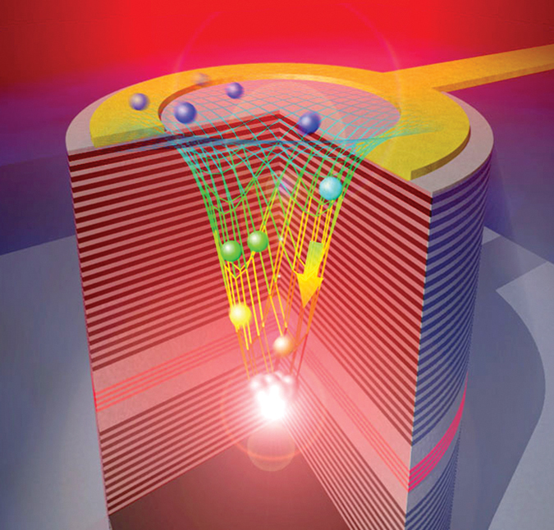
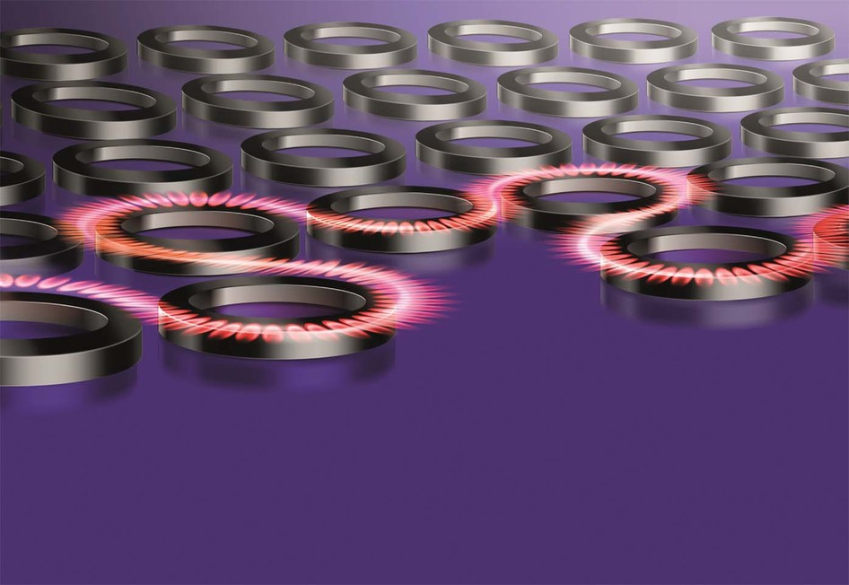
Fresh ideas
PT symmetry
Topological photonics
Polariton photonics
Notes:
And now we move on to talk about PT symmetry in optical structures.
We first note that over the last two decades, the field has witnessed a very rapid advance in the material technology that enabled a great control over molding light behavior.
Probably the most prominent examples are photonic band gap materials, metamaterials, plasmonics as well as photonic crystal fibers.
In all these technologies, optical loss has been always considered an obstacle and many efforts have been dedicated to get rid of it.
And this became the conventional wisdom in the field.

Slide 7
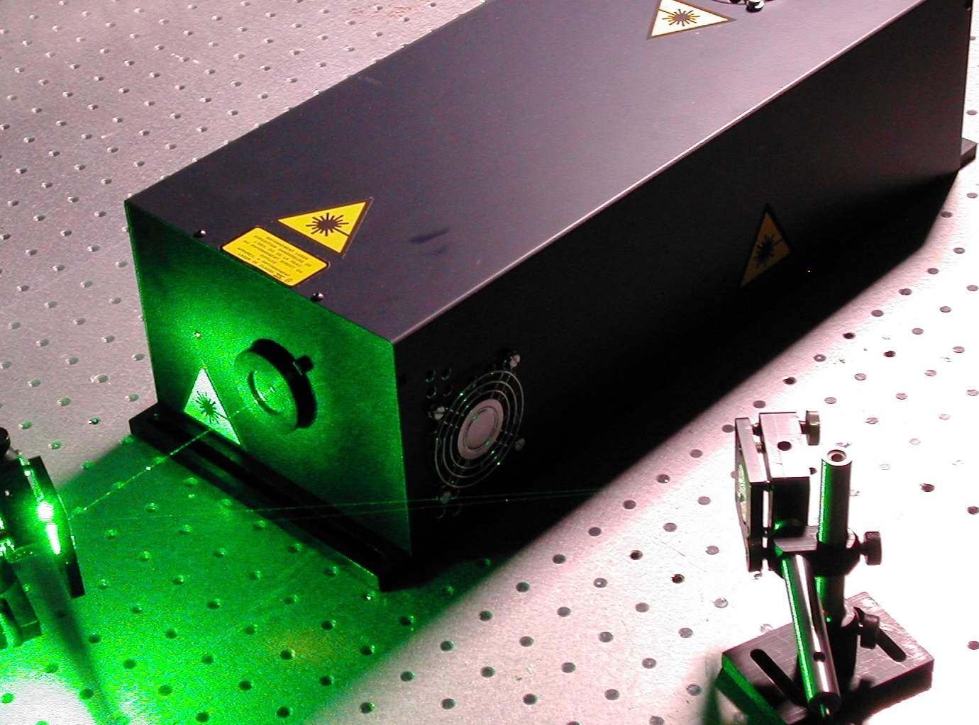
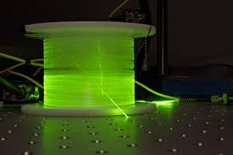
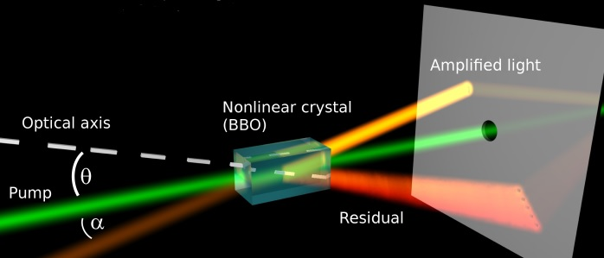
Non-Hermitian Optics?
Lasers
Fiber amplifiers
Parametric amplifiers
Notes:
And now we move on to talk about PT symmetry in optical structures.
We first note that over the last two decades, the field has witnessed a very rapid advance in the material technology that enabled a great control over molding light behavior.
Probably the most prominent examples are photonic band gap materials, metamaterials, plasmonics as well as photonic crystal fibers.
In all these technologies, optical loss has been always considered an obstacle and many efforts have been dedicated to get rid of it.
And this became the conventional wisdom in the field.

Slide 8
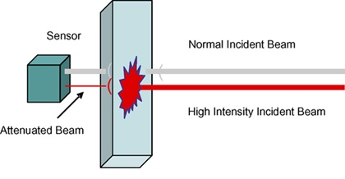
Non-Hermitian Optics?
Refractive index,
gain and loss???
Refractive index
Gain
Loss
Optical limiters
Lasers
Notes:
And now we move on to talk about PT symmetry in optical structures.
We first note that over the last two decades, the field has witnessed a very rapid advance in the material technology that enabled a great control over molding light behavior.
Probably the most prominent examples are photonic band gap materials, metamaterials, plasmonics as well as photonic crystal fibers.
In all these technologies, optical loss has been always considered an obstacle and many efforts have been dedicated to get rid of it.
And this became the conventional wisdom in the field.

Slide 9
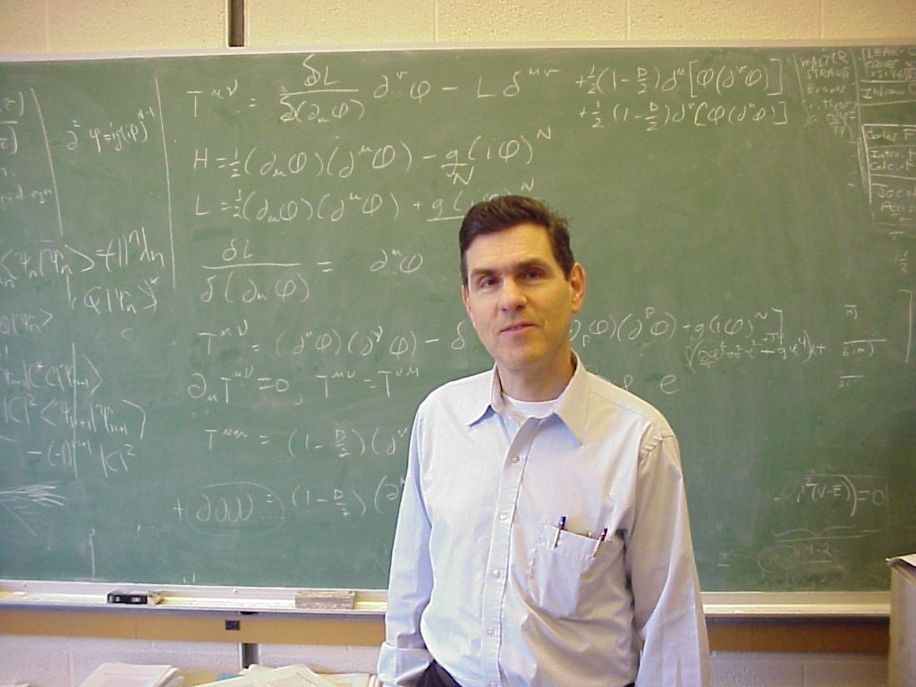
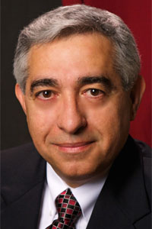
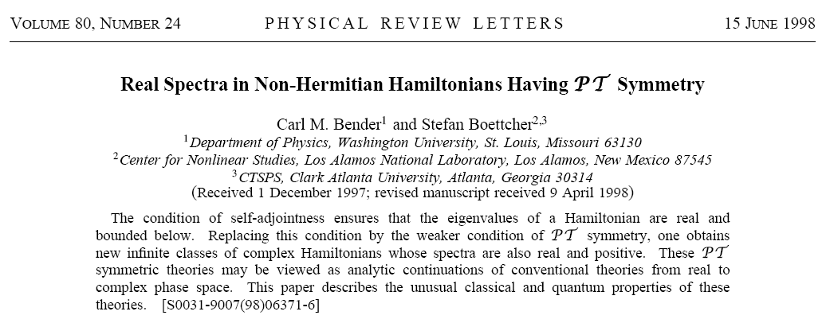
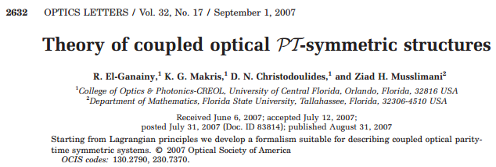
Non-Hermitian Optics
PT symmetric QM
PT symmetry in optics

Slide 10
Supersymmetric laser arrays
Ramy El-Ganainy , Li Ge² and D.N. Christodoulides³
¹Michigan Technological University (MTU)
²City University of New York (CUNY)
³University of Central Florida (UCF)

Slide 11
Motivation
Single transverse mode high power laser arrays
E. Kapon, J. Katz and A. Yariv, Optics Lett, 10, 125 (1984)
H. G. Winful and S. S. Wang, APL, 53, 1894 (1988)
A. F. Glova, Quantum Electronics, 33, 283 (2003)
Notes:
And now we move on to talk about PT symmetry in optical structures.
We first note that over the last two decades, the field has witnessed a very rapid advance in the material technology that enabled a great control over molding light behavior.
Probably the most prominent examples are photonic band gap materials, metamaterials, plasmonics as well as photonic crystal fibers.
In all these technologies, optical loss has been always considered an obstacle and many efforts have been dedicated to get rid of it.
And this became the conventional wisdom in the field.

Slide 12
Outline:
Supersymmetry (SUSY)
Supersymmetry (SUSY) in optics
Connection to PT symmetry
Discrete SUSY
Laser arrays
Supersymmetric laser arrays
Conclusions

Slide 13
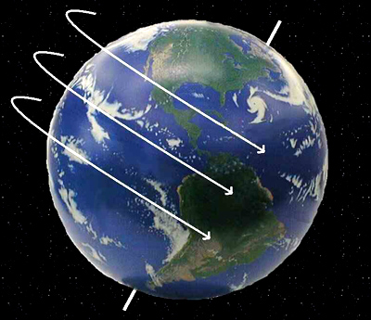
Symmetry in physics
Continuous symmetries:
Discrete symmetries:

Slide 14
What is supersymmetry (SUSY)?
Schwarz & Seiberg, Rev. Mod. Phys. 71, S112 (1999)
Notes:
Schwarz & Seiberg, Rev. Mod. Phys. 71, S112 (1999)

Slide 15
Supersymmetry in quantum mechanics
Relation between superpartners:
Factorization:
E. Witten, Nucl. Phys. B188, 513 (1981).
Cooper et al., “Supersymmetry in Quantum Mechanics,” World Scientific (2001)

Slide 16
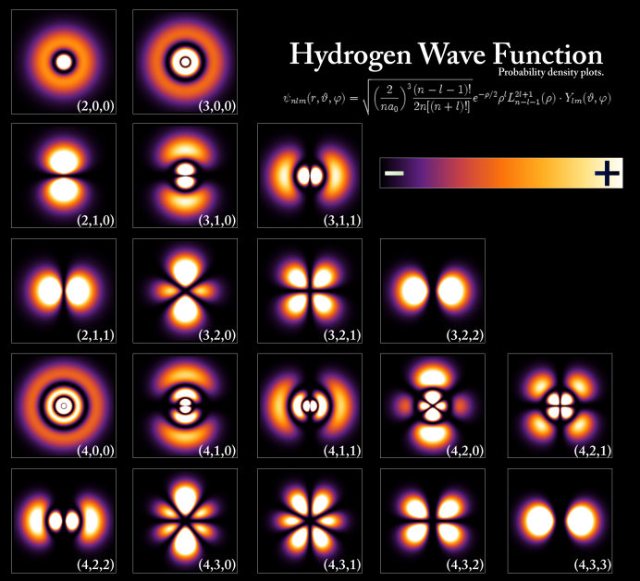
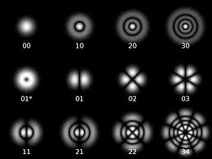
Supersymmetry in optics
QM
EM
Schrodinger equation
Maxwell’s equations
Energy eigenvalues
Propagation constants/Resonant frequencies
Notes:
And at this point we enter the game with a very modest goal which is to come up with physical system where PT symmetry can be implemented. Of course hoping to go beyond that and demonstrating some intriguing effects but our initial goal was very down to earth.
And the idea was very simple, at least theoretically. We know that the propagation of wide beams respects an equation of diffraction analogous to Schrodinger equation, apart from replacing the time variable with z. We also know that potentials in SE can be realized using the so called optical potential which is nothing more than engineering the spatial distribution of refractive index. So complex potential would me complex refractive index profile which can be achieved using gain and loss. Even though the idea is very simple but it was exciting to even think that loss might be useful.

Slide 17
PT symmetry and SUSY relations

Slide 18
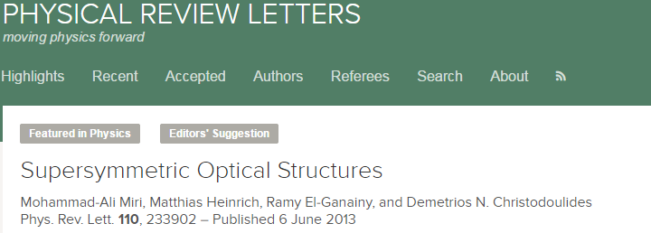
SUSY optical structures
Multimode waveguide
SUSY partner
Refractive index [10⁻³]
$$n^{\left(1\right)}(x)$$
$$n^{\left(2\right)}(x)$$
Position [µm]
Position [µm]
Notes:
Effective index $\mu$
W=-\partial_x\ln\psi_1^{(1)}

Slide 19
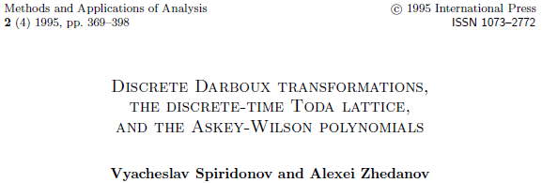
Discrete SUSY
Waveguide array
SUSY partner array
?
Cholesky decomposition
QR factorization
Notes:
Effective index $\mu$
W=-\partial_x\ln\psi_1^{(1)}

Slide 20
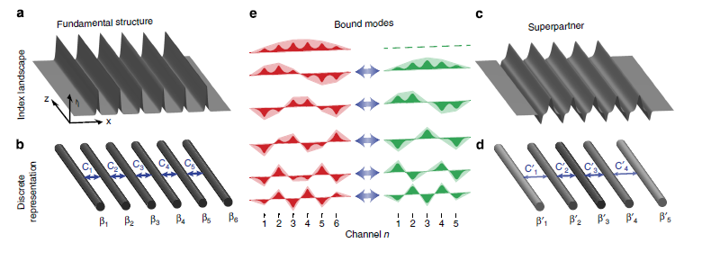
Discrete SUSY
Waveguide array
SUSY partner array
Notes:
Effective index $\mu$
W=-\partial_x\ln\psi_1^{(1)}

Slide 21
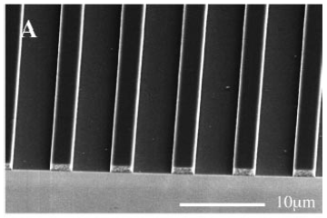
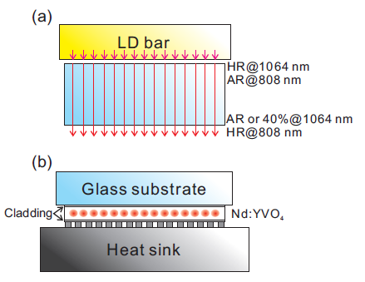
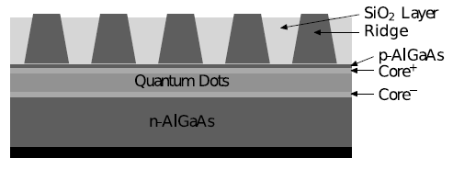
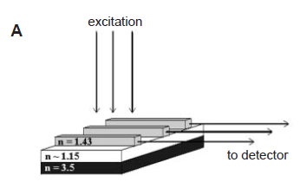
Back to laser arrays
Peidong Yang, et al, Science 287, 465 (2000)
Proceedings of the World Congress on Engineering 2009 , Vol II
Optics Express, 21, 24952 (2013)

Slide 22
SUSY laser arrays
SUSY array in isolation
Coupled SUSY arrays
Single array
Coupled SUSY arrays
Doublets
Doublets
Singlet
Singlet

Slide 23
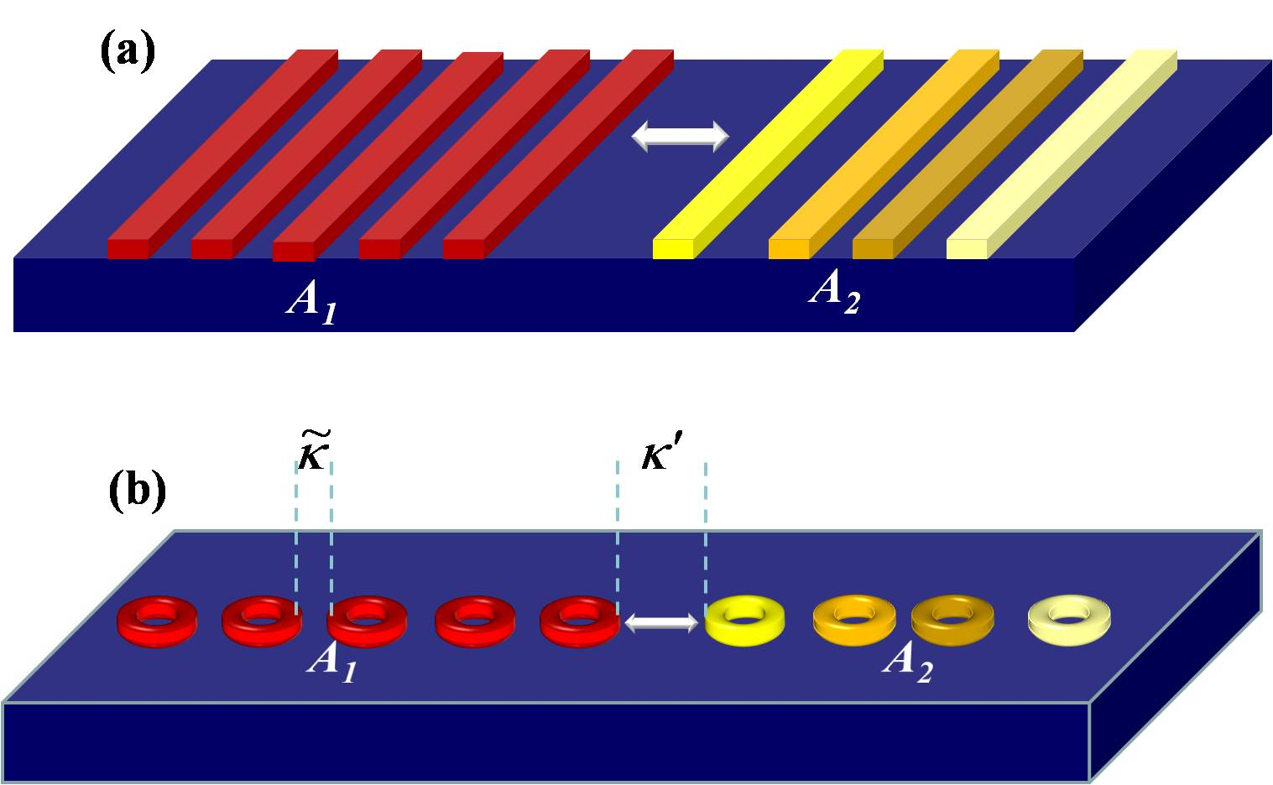
SUSY laser arrays
Example:

Slide 24
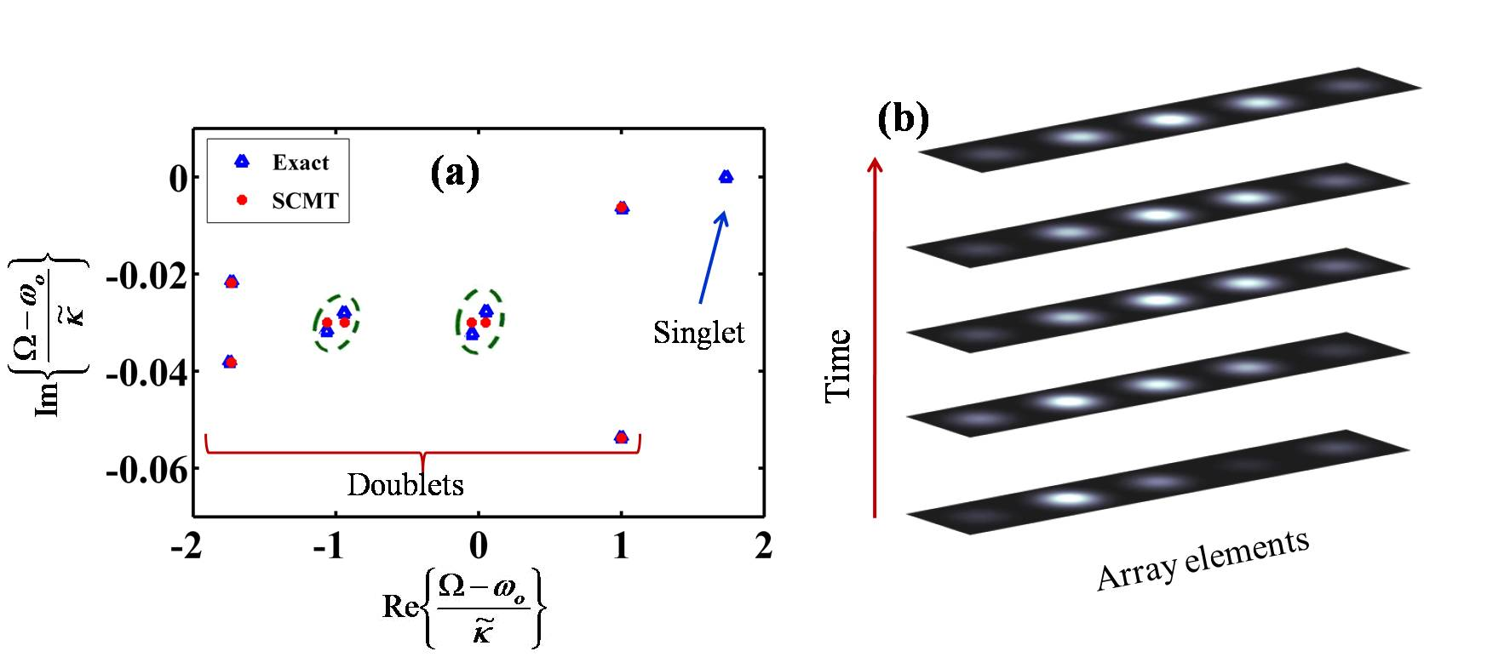
SUSY laser arrays: lasing thresholds

Slide 25
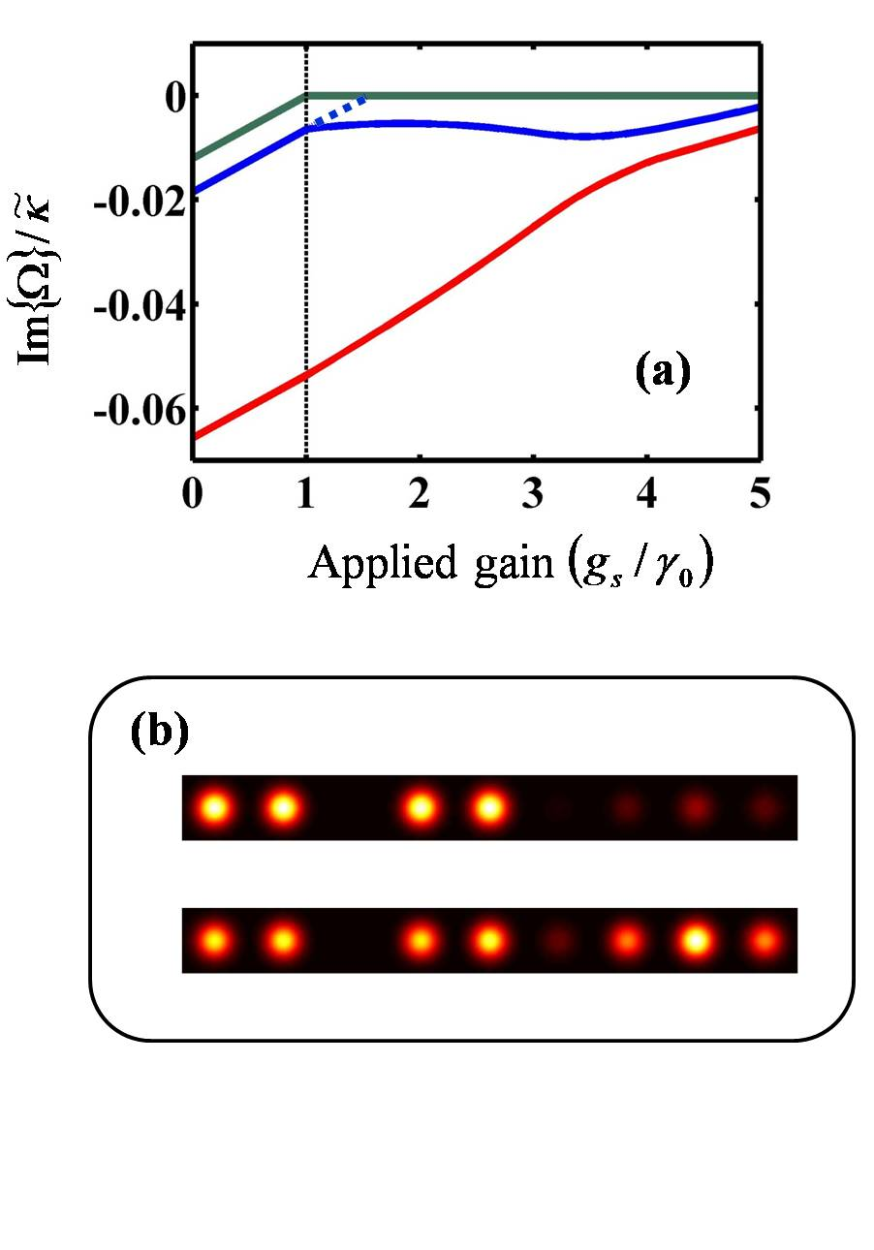
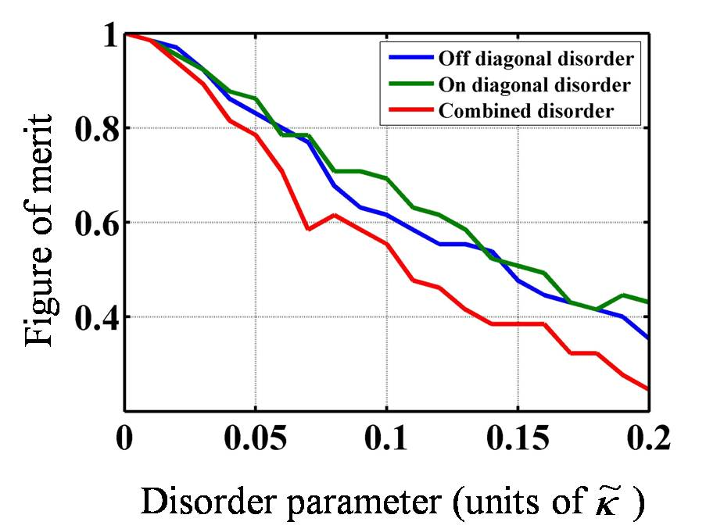
SUSY laser arrays: disorder and nonlinearity

Slide 26
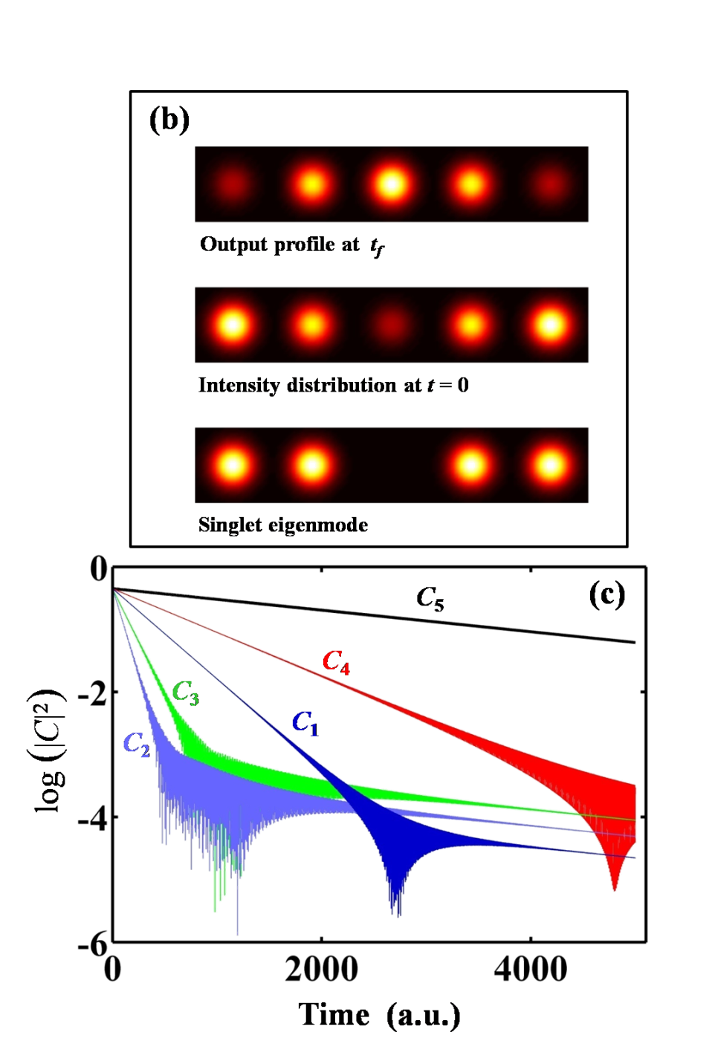
SUSY laser arrays: non-resonant interaction
(a)
Brillouin-Wigner
Singlet
El-Ganainy at al,arXiv: 1501.02972

Slide 27
SUSY laser arrays
To do list:
1. Emission dynamics: chaotic vs. regular behavior
2. Nonlinear effects: filamentation
3. Implementation
4. Experimental realization
4. Quantum effects: emission linewidth

Slide 28
Conclusion:
Supersymmetry in optics: mini-review
Supersymmetric laser arrays
Single transverse mode operation
Challenges

Slide 29
Thank you

