Slide 1


Semiclassical dynamics in the presence of loss and gain
Eva-Maria Graefe
Department of Mathematics, Imperial College London, UK
joint work with Roman Schubert, Hans Jürgen Korsch, and Alexander Rush
Department of Mathematics, University of Bristol, UK
Department of Physics, TU Kaiserslautern, Germany
Department of Mathematics, Imperial College London, UK
Non-Hermitian Photonics in Complex Media: PT-symmetry and beyond
Heraklion, Crete, June 2016

Slide 2
Outline
Beam dynamics with gain and loss:
Schrödinger dynamics in wave guides, semiclassical limit with Gaussians wave packets, a PT-symmetric wave guide
Semiclassical limit of non-Hermitian quantum systems – a general structure
Quasiclassical description of Bloch oscillations in non-Hermitian lattices:
Tight-binding Hamiltonian, Bloch oscillations, classical explanation, non-Hermitian case

Slide 3
Beam propagation in optical waveguides
Propagation of electric field amplitude in paraxial approximation in direction :
Effective
Reference refractive index
Refractive index modulation in x direction:
Gaussian approximation yields “geometric optics” beam dynamics
Notes:
Potential from paper, example showing how width influences things

Slide 4
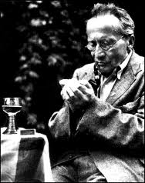
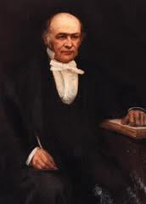
From quantum to classical dynamics
Quantum dynamics:
Schrödinger equation
Classical Hamiltonian dynamics:
Erwin Schrödinger
Nobel Prize 1933
Sir William Rowan Hamilton
1805 - 1865
Semiclassical limit: Gaussian quantum wave packets move approximately according to classical dynamics

Slide 5
“Semiclassical” (Beam) dynamics
Initial Gaussian beam:
B encodes uncertainties:
Hepp, Heller, Littlejohn 1970‘s

Slide 6
“Semiclassical” (Beam) dynamics
Initial Gaussian beam:
B encodes uncertainties:
Ansatz for time-evolved state:
Hepp, Heller, Littlejohn 1970‘s

Slide 7
“Semiclassical” (Beam) dynamics
Ansatz for time-evolved state:
Taylor expansion of potential yields
Hepp, Heller, Littlejohn 1970‘s

Slide 8
“Semiclassical” (Beam) dynamics
Ansatz for time-evolved state:
Taylor expansion of potential yields
Alternative “derivation”: Ehrenfest theorem
Hepp, Heller, Littlejohn 1970‘s

Slide 9
Beam optics in the presence of loss and gain
Complex refractive index models absorption and amplification
EMG, Rush, Schubert, arXiv:16.01.07802

Slide 10
Beam optics in the presence of loss and gain
Complex refractive index models absorption and amplification
Initial Gaussian beam:
Ansatz for time-evolved state:
EMG, Rush, Schubert, arXiv:16.01.07802

Slide 11
Beam optics in the presence of loss and gain
Gaussian approximation and quadratic Taylor expansion around centre yields:
EMG, Rush, Schubert, arXiv:16.01.07802

Slide 12
Example: PT-symmetric wave guide
Gaussian approximation expected to be good for large
EMG, Rush, Schubert, arXiv:16.01.07802

Slide 13
Example: PT-symmetric wave guide
Guassian approximation (top) and exact numerical propagation (bottom),
EMG, Rush, Schubert, arXiv:16.01.07802

Slide 14
Example: PT-symmetric wave guide
Guassian approximation (top) and exact numerical propagation (bottom),
EMG, Rush, Schubert, arXiv:16.01.07802

Slide 15
Beam optics without absorption
EMG, Rush, Schubert, arXiv:16.01.07802

Slide 16
Beam optics with absorption
EMG, Rush, Schubert, arXiv:16.01.07802

Slide 17
Outline
Beam dynamics with gain and loss:
Schrödinger dynamics in wave guides, semiclassical limit with Gaussians wave packets, a PT-symmetric wave guide
Semiclassical limit of non-Hermitian quantum systems – a general structure
Quasiclassical description of Bloch oscillations in non-Hermitian lattices:
Tight-binding Hamiltonian, Bloch oscillations, classical explanation, non-Hermitian case

Slide 18
“Semiclassical” dynamics – general structure
Time evolution with general non-Hermitian Hamiltonian:
Ansatz for time-evolved state:
Taylor expansion of H around centre of wave packet up to second order
Coupled dynamical equations for phase space coordinates and (co)variances

Slide 19
“Semiclassical” dynamics – general structure
With covariance matrix
EMG, R. Schubert, PRA 83, 060101(R) (2011) , EMG, H.J. Korsch, and A. Rush, arXiv:1604.01885

Slide 20
“Semiclassical” dynamics – general structure
With covariance matrix
EMG, R. Schubert, PRA 83, 060101(R) (2011) , EMG, H.J. Korsch, and A. Rush, arXiv:1604.01885

Slide 21
“Semiclassical” dynamics – general structure
With covariance matrix
EMG, R. Schubert, PRA 83, 060101(R) (2011) , EMG, H.J. Korsch, and A. Rush, arXiv:1604.01885

Slide 22
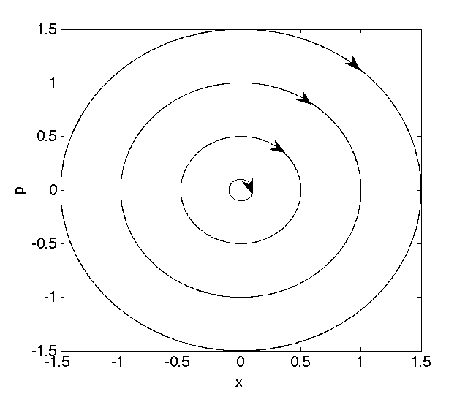
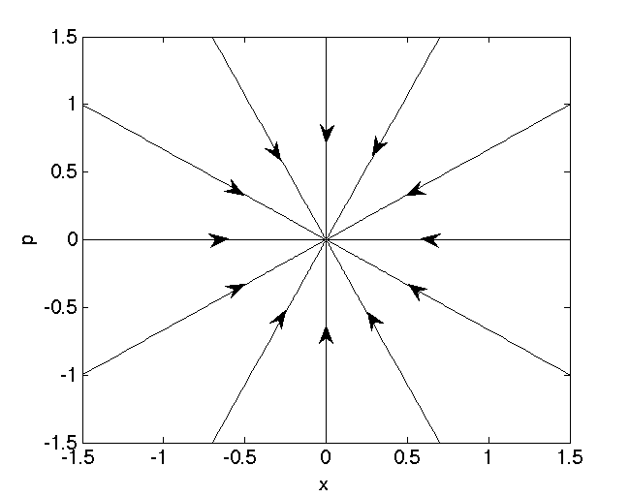
The generalised canonical equations
Hermitian part:
symplectic flow
p
p
Anti-Hermitian part:
metric flow
q
q
Hamiltonian (conservative) dynamics
Aims to drive the dynamics on the “direct” way towards a minimum of .
EMG, M. Höning, and H. J. Korsch J. Phys. A 43, 075306 (2010)

Slide 23
“Semiclassical” dynamics – general structure
Dynamics of position and momentum
Coupled to covariance dynamics
Resulting dynamics of squared norm/total power:
EMG, R. Schubert, PRA 83, 060101(R) (2011) , EMG, H.J. Korsch, and A. Rush, arXiv:1604.01885

Slide 24
Outline
Beam dynamics with gain and loss:
Schrödinger dynamics in wave guides, semiclassical limit with Gaussians wave packets, a PT-symmetric wave guide
Semiclassical limit of non-Hermitian quantum systems – a general structure
Quasiclassical description of Bloch oscillations in non-Hermitian lattices:
Tight-binding Hamiltonian, Bloch oscillations, classical explanation, non-Hermitian case

Slide 25
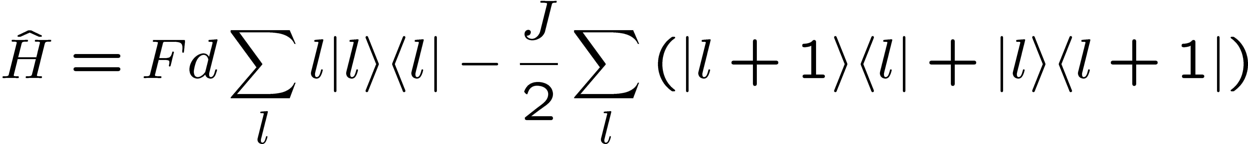
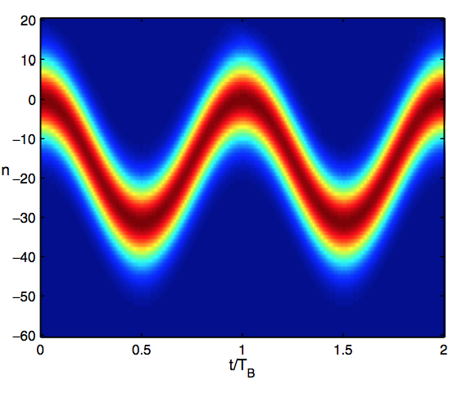
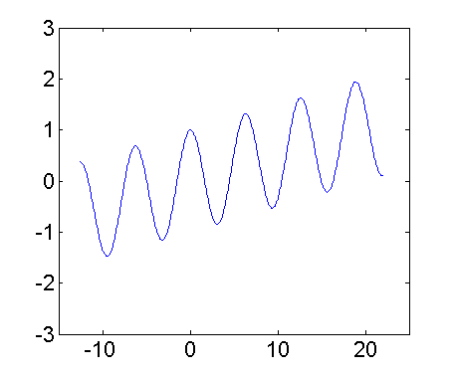
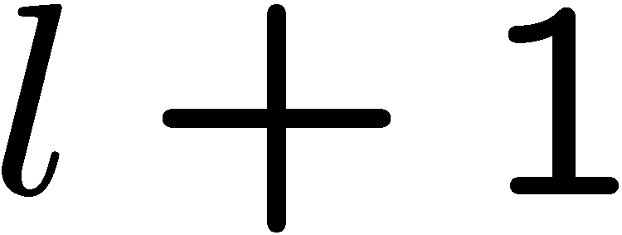


Single-band tight-binding Hamiltonian
On-site energy
Tunneling/hopping between sites
Lattice site
T. Hartmann, F. Keck, S. Mossmann, and H.J. Korsch, New J. Phys. 6 (2004) 2

Slide 26
Algebraic formulation
With the shift algebra

Slide 27
Algebraic formulation
With the shift algebra
Define quasimomentum operator via
“Conjugate” of the discrete position operator:

Slide 28
Bloch oscillations – quasiclassical explanation
Heisenberg equations of motion
Acceleration theorem:
Ehrenfest theorem:

Slide 29
Non-Hermitian tight-binding lattice
Quasiclassical dynamics?
S. Longhi, PRA 92, 042116 (2015)

Slide 30
Non-Hermitian tight-binding lattice
Quasiclassical dynamics?
Modified Heisenberg equations of motion
not directly useful…
S. Longhi, PRA 92, 042116 (2015)

Slide 31
“Semiclassical” dynamics – general structure
Dynamics of position and momentum
Coupled to covariance dynamics
Resulting dynamics of squared norm/total power:
EMG, H.J. Korsch, and A. Rush, arXiv:1604.01885

Slide 32
Limit of narrow momentum packets
Can be analytically solved to yield:
Acceleration theorem:
EMG, H.J. Korsch, and A. Rush, arXiv:1604.01885

Slide 33
Limit of narrow momentum packets
Can be analytically solved to yield:
Acceleration theorem:
Dynamics of centre:
Constant covariance
Fieldfree dispersion relation:
EMG, H.J. Korsch, and A. Rush, arXiv:1604.01885

Slide 34
Limit of narrow momentum packets
Can be analytically solved to yield:
Acceleration theorem:
Dynamics of centre:
Constant covariance
Fieldfree dispersion relation:
Evolution of total power:
EMG, H.J. Korsch, and A. Rush, arXiv:1604.01885

Slide 35
Limit of narrow momentum packets
Can be analytically solved to yield:
Acceleration theorem:
Dynamics of centre:
Constant covariance
Fieldfree dispersion relation:
Evolution of total power:
Exact for vanishing momentum width!
EMG, H.J. Korsch, and A. Rush, arXiv:1604.01885

Slide 36
Example: Hatano-Nelson lattice
Simple mapping to Hermitian Hamiltonian and analytical solution
Experimental realisation in optical resonator structures proposed by Longhi
Classical Hamiltonian:
EMG, H.J. Korsch, and A. Rush, arXiv:1604.01885

Slide 37
Example: Hatano-Nelson lattice
Propagation of (wide) Gaussian beam
EMG, H.J. Korsch, and A. Rush, arXiv:1604.01885

Slide 38
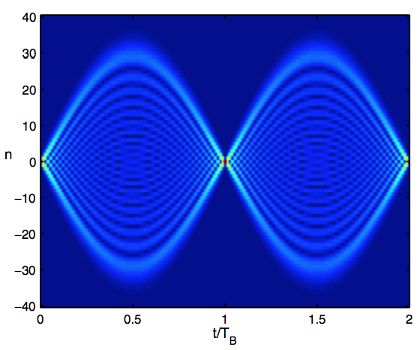
Breathing modes
Propagation of single site initial state in Hermitian case
Quasiclassical dynamics not valid, but can be explained as classical ensemble
T. Hartmann, F. Keck, S. Mossmann, and H.J. Korsch, New J. Phys. 6 (2004) 2

Slide 39
Breathing modes in a Hatano-Nelson lattice
EMG, H.J. Korsch, and A. Rush, arXiv:1604.01885

Slide 40
Quasiclassical breathing mode
Interpret Fourier transform of initially localised state as (incoherent) ensemble of infinitely narrow momentum wavepackets!
Quantum propagation:
Classical ensemble:
EMG, H.J. Korsch, and A. Rush, arXiv:1604.01885

Slide 41
Summary
Beam dynamics with gain and loss:
Schrödinger dynamics in wave guides, semiclassical limit with Gaussians wave packets, a PT-symmetric wave guide
Semiclassical limit of non-Hermitian quantum systems – a general structure
Quasiclassical description of Bloch oscillations in non-Hermitian lattices:
Tight-binding Hamiltonian, Bloch oscillations, classical explanation, non-Hermitian case

Slide 42
Summary
Beam dynamics with gain and loss:
Schrödinger dynamics in wave guides, semiclassical limit with Gaussians wave packets, a PT-symmetric wave guide
Thank you for your attention!
Semiclassical limit of non-Hermitian quantum systems – a general structure
Quasiclassical description of Bloch oscillations in non-Hermitian lattices:
Tight-binding Hamiltonian, Bloch oscillations, classical explanation, non-Hermitian case

